Slide 1
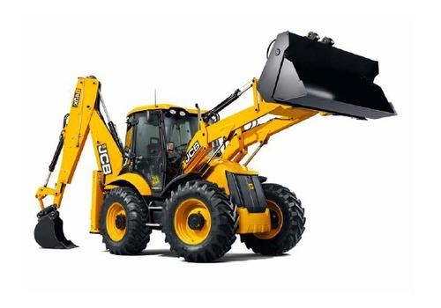
KIRLOSKAR JCB 3DX FILTERS

Slide 2
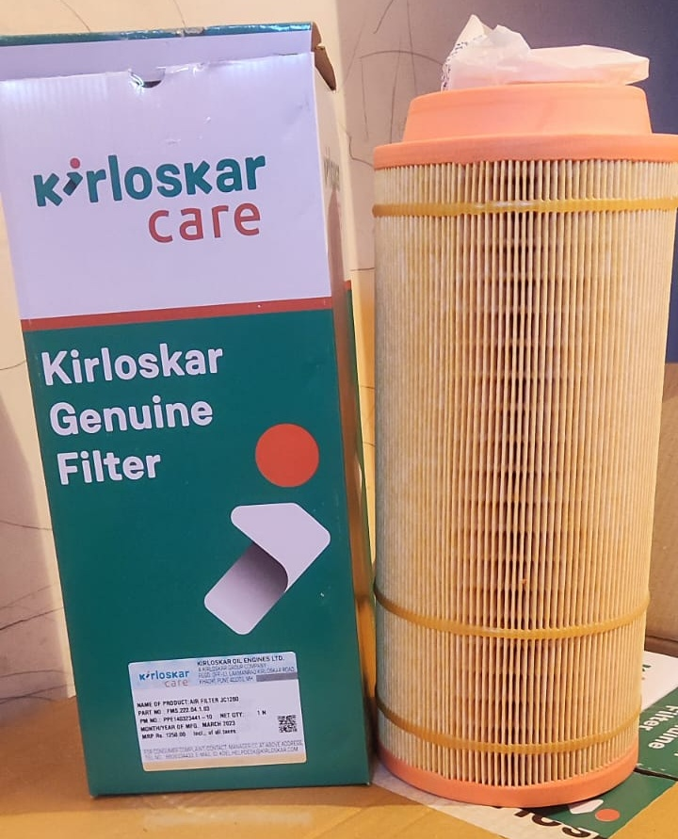
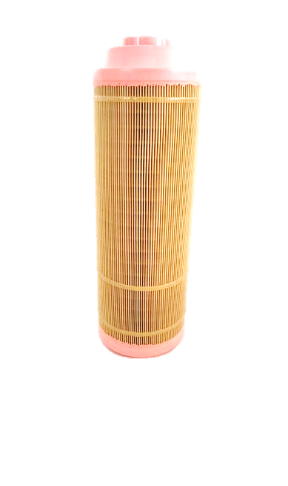
AIR FILTER 335/JC1280
KOEL PART NO : FMS.222.04.1.03
KOEL DESCRIPTION : Air Filter JC1280
MRP : 1250
MOQ : 12
APPLICATION MODEL : JCB 3DX

Slide 3
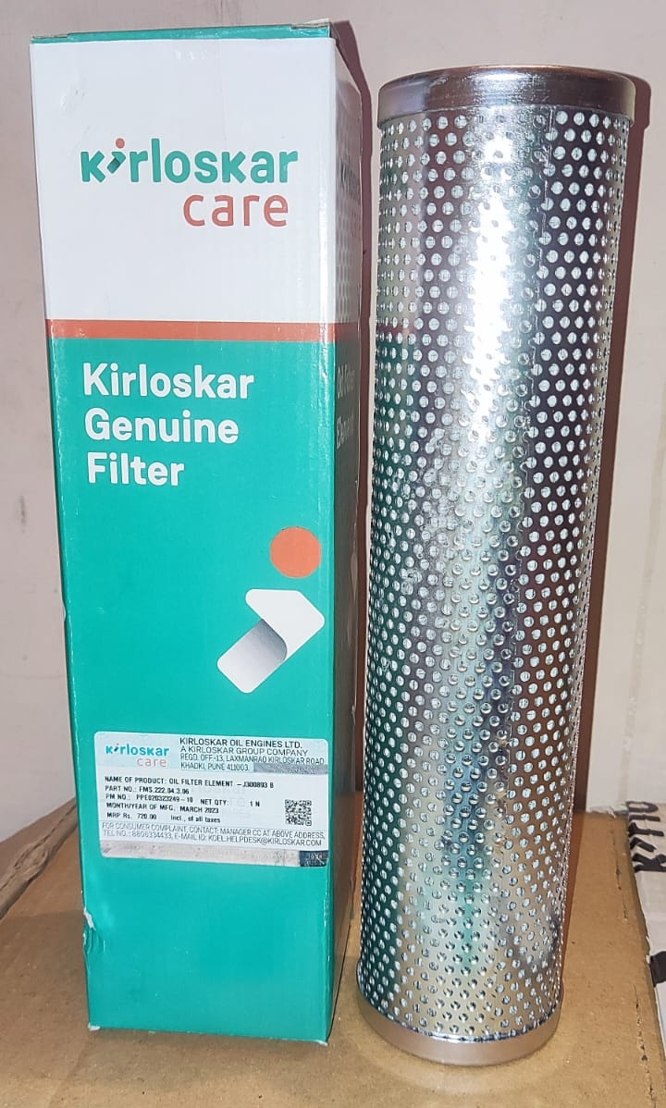
HYDRAULIC FILTER / Oil filter Element -J300893 Backhoe loader
KOEL PART NO : FMS.222.04.3.06
DESCRIPTION : Oil filter Element -J300893 Backhoe loader
MRP : Rs 720
MOQ : 10
APPLICATION MODEL : JCB 3DX CONCRETE MIXER

Slide 4
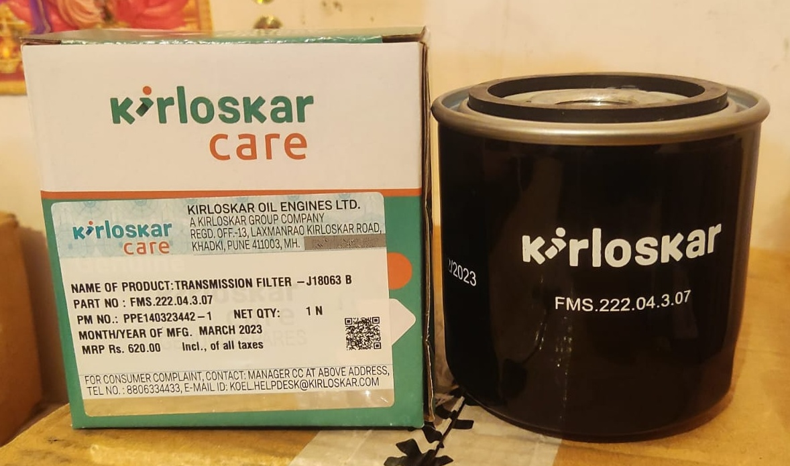
TRANSMISSION FILTER / -J18063 Backhoe loader
KOEL PART NO : FMS.222.04.3.07
DESCRIPTION : TRANSMISSION FILTER J18063 Backhoe loader
MRP : Rs 620
MOQ : 10
APPLICATION MODEL : JCB 3CX ,JCB 3DX. FORKLIFT,JCB 2CX,JCB 4CX, JCB 526-56, JCB 531-70, JCB 535-125,
JCB0535-140, JCB 536-70 AGRI SUPE JCB 540/140,
JCB 540/170, JCB 541/70, JCB 528S, JCB535-95 LOADER, JCB 3CX 4T

Slide 5
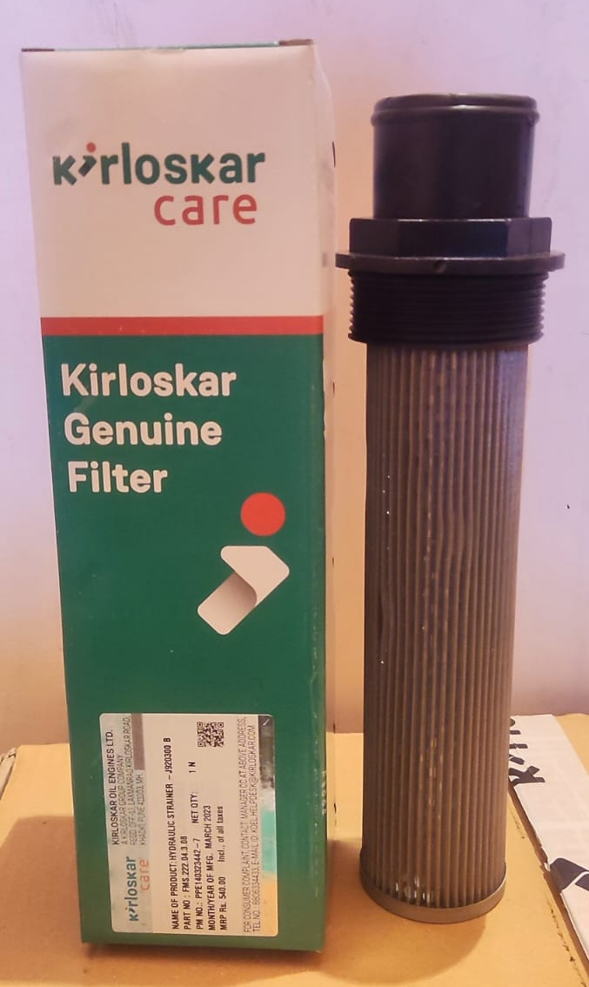
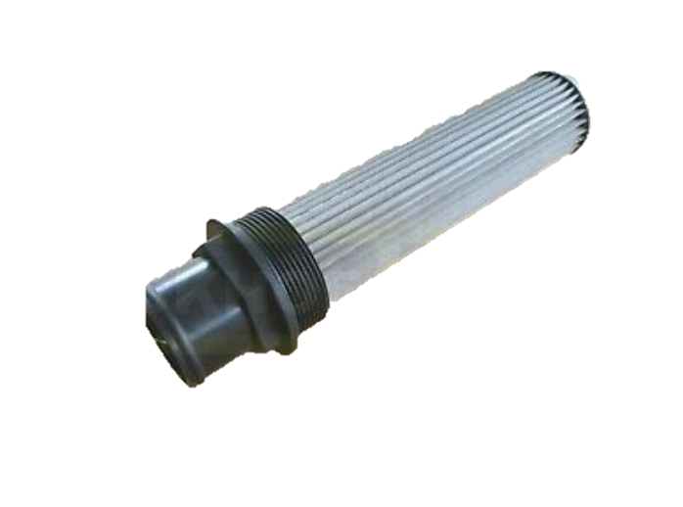
HYDRAULLIC FILTER ELEMENT SUCTION/-J920300 Backhoe loader
KOEL PART NO : FMS.222.04.3.08
DESCRIPTION : HYDRAULIC STRAINER -J920300
Mrp : Rs 540
MOQ : 10
APPLICATION MODEL : JCB 3DX CONCRETE MIXER

Slide 6
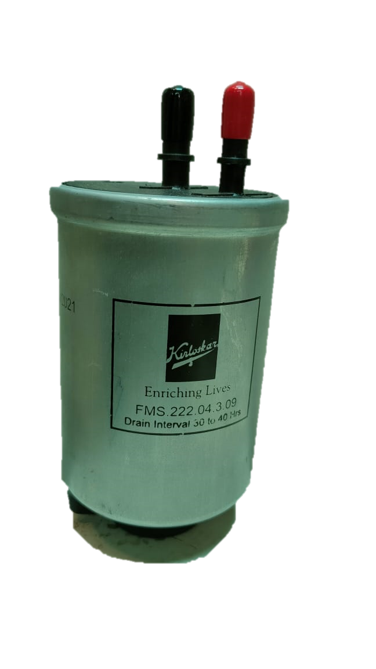
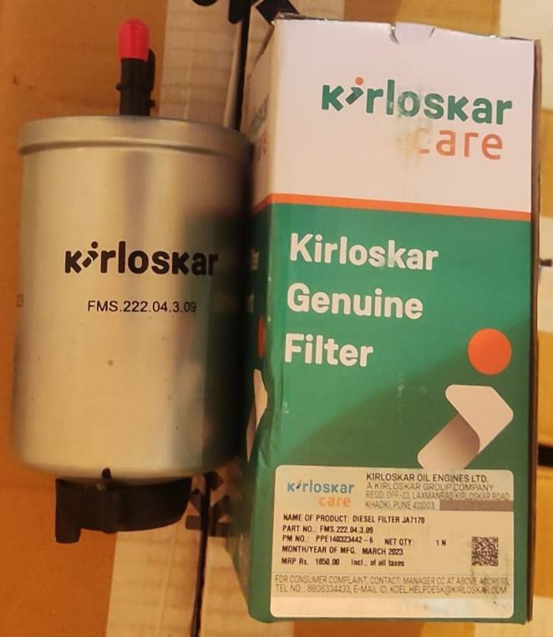
FUEL FILTER /DIESEL FILTER JA7170
KOEL PART NO : FMS.222.04.3.09
DESCRIPTION : FUEL FILTER / DIESEL FILTER JA7170
MOQ :- 10
MRP : 1850
APPLICATION MODEL : JCB 3 DX , JCB 3 DX SUPER

Slide 7
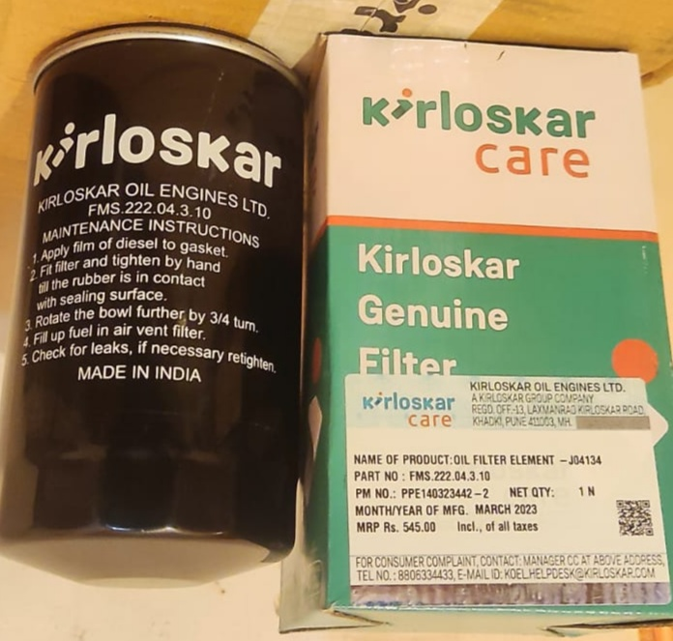
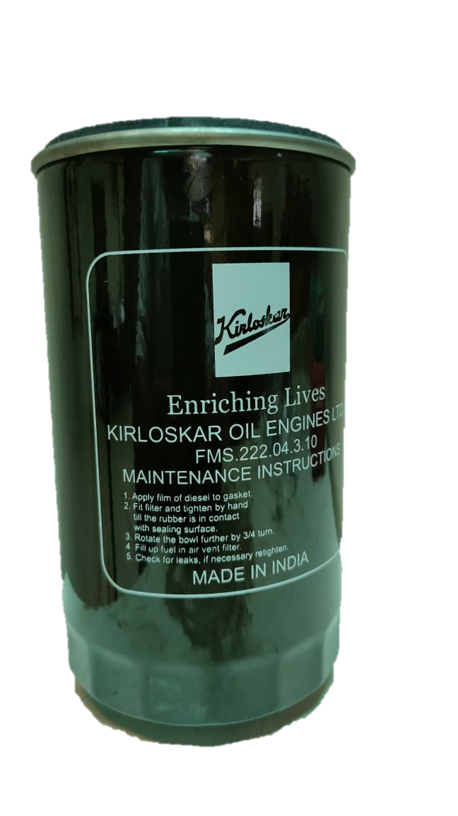
ENGINE OIL FILTER /Oil filter Element -J04134
JCB PART NO : 320/04134
KOEL PART NO : FMS.222.04.3.10
DESCRIPTION : ENGINE OIL FILTER /OIL F FILTER ELEMENT J04134
MRP : Rs 545
MOQ 10
APPLICATION MODEL : JCB 3 DX BACKHOE

Slide 8
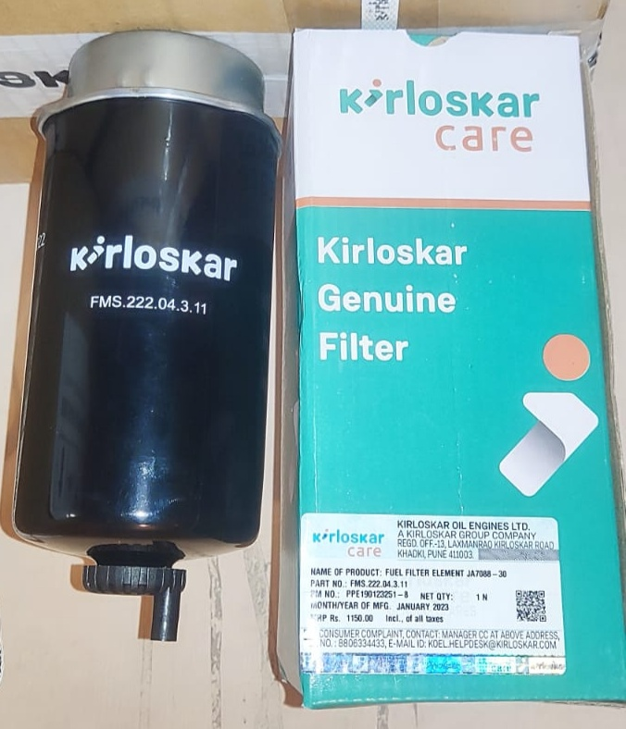
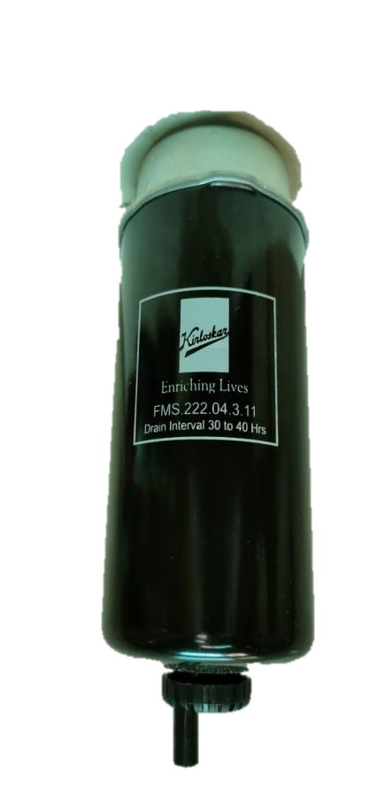
FUEL WATER SEPARATOR/Fuel Filter element JA7088-30M
KOEL PART NO : FMS.222.4.3.11
DESCRIPTION : FUEL WATER SEPARATOR /Fuel Filter element 320/JA7088-30M
MRP : 1150
MOQ : 10
APPLICATION MODEL : JCB 3 CX, JCB 3DX BACKHOE

Slide 9
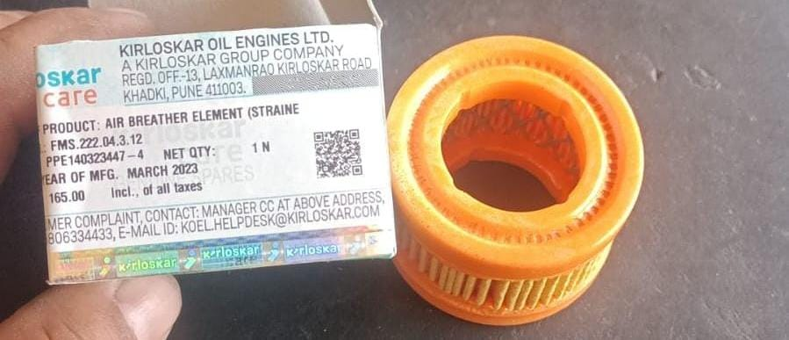
Air Breather Element (Strainer) - 550/43485
KOEL PART NO : FMS.222.04.3.12
DESCRIPTION : Air Breather Element (Strainer) - 550/43485
MRP : Rs 165
MOQ : 10
APPLICATION MODEL : JCB 3 CX, JCB 3DX BACKHOE

Slide 10
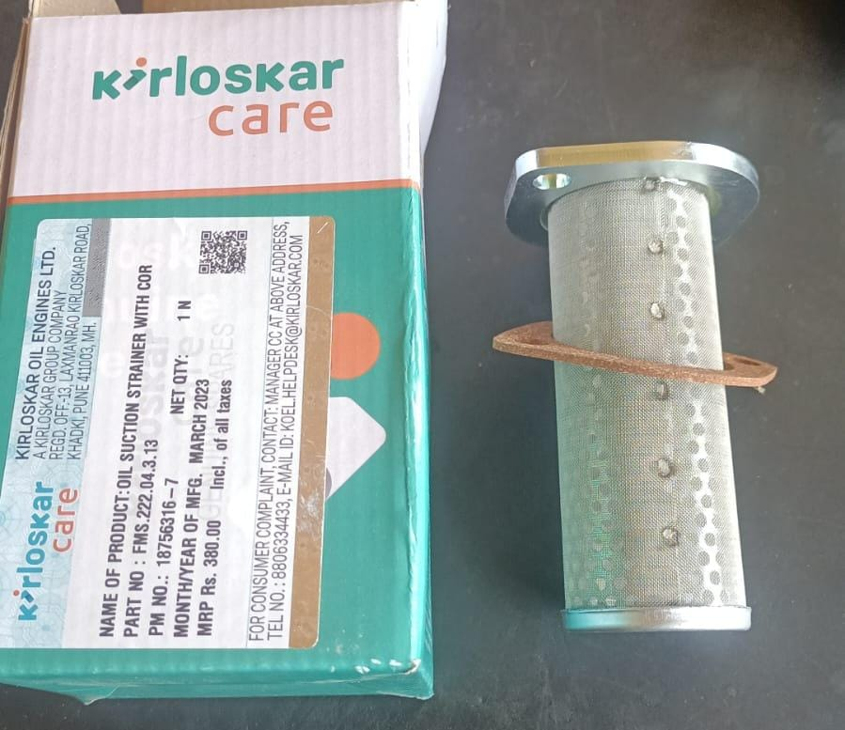
Oil Suction Strainer with Cork Gasket - 32/902200
KOEL PART NO : FMS.222.04.3.13
DESCRIPTION : Oil Suction Strainer with Cork Gasket - 32/902200
MRP : Rs 380
MOQ : 10
APPLICATION MODEL : JCB 3 CX, JCB 3DX BACKHOE

Slide 11
More filters are coming soon……….

